Slide 1
Hatley App

Slide 2
Team Members
Abdallah Salah | Back-end Developer (Asp.net)
Rahma Bahaa | Back-end Developer (Asp.net)
Ahmed Ali | Front-end Developer Web (React)
Santy Osama | Front-end Developer Web (React)
Abdelrahman Omar | front-end Developer Mobile (React Native)

Slide 3
Table of contents
01
02
03
04
Proplem definition
Our Solution
System Details
Prototype
05
Conclusion

Slide 4
01
Problem definition
Simple description about the problem

Slide 5
Problem Form
01
02
User Perspective
Delivery Perspective
purchasing daily essentials.
People with busy schedules.
lack of access to a wide range of products.
small and medium-sized stores.
Delay of the delivery companies in responding.
The greed of the delivery men when ordering orders From various categories.
distance from store.
purchasing daily essentials.
Delivery companies often take a large percentage of the delivery fee, leaving delivery drivers with a smaller portion of the earnings.
Commitment to specific working hours
His inability to work as a delivery man as a part time job.

Slide 6
Survey

Slide 7
Survey

Slide 8
Survey

Slide 9
Survey

Slide 10
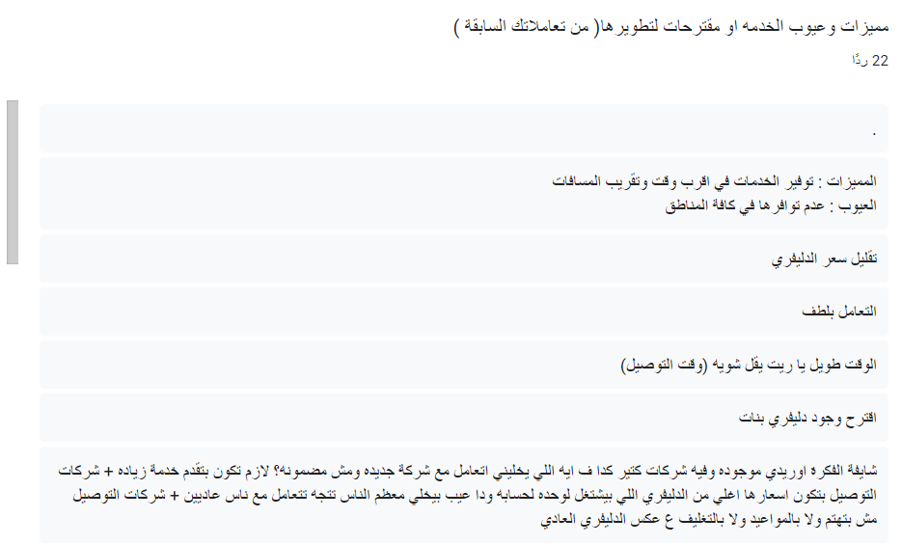
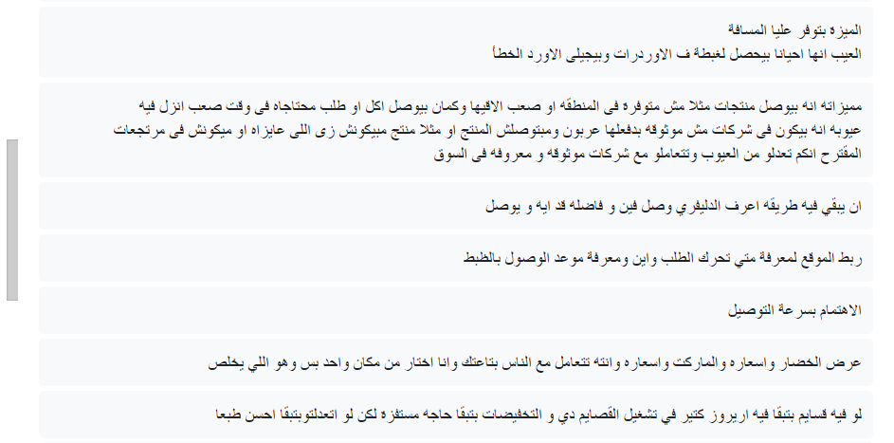
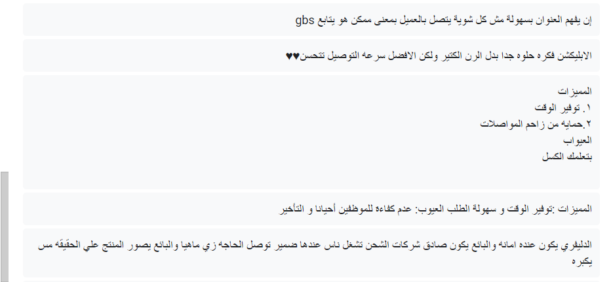
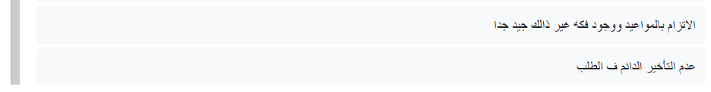
Survey

Slide 11
02
Our Solution
Simple Description about the Solution

Slide 12

Application Hatley
We decide to
Create

Slide 13

Motivation
provide a fast, convenient, and transparent delivery service that connects users with a wide range of products and services.
By allowing delivery personnel to compete for orders based on price and time, the platform can help to incentivize faster and more efficient delivery services, while also providing users with greater choice and flexibility.
Additionally, by providing
Job opportunities for young individuals and helping to transform the Egyptian market into a more competitive space, the platform can help to increase revenue and product availability for smaller stores, while also providing consumers with greater access to essential goods and services.

Slide 14


Our Platfrom
Web
Android
We Are Using React js as main framework
We are developing the Android application in React Native
IOS
Backend server
We are developing the IOS application in React Native
We will use Asp.net as a Backend Framework

Slide 15
03
System Details
What our app is include

Slide 16
Use Cases
Create Order
02
Display Requests
01
Notification Alert
04
Introduce Offer
03
Request Tracking
06
Request Tracking
05
User Rating
07

Slide 17
Create Order
Use Case Name: Create Order |  | ID: UC_4 | Priority: High
Description | This use case describes how the user will make an order.
Actor | User
Precondition | The user opens the system. The user must log in.
Normal Course | The user clicks "make an order" button. The system opens the form to the user to fill it out. The user writes the name of items he\she needs. The user writes the quantity he\she needs. The user specifies the available budget he\she can pay. The user can attach a photo or file if he\she wants(optional). The user clicks "Done" button.
Postcondition | The system will redirect the user to location selection interface. The system will redirect the user to location selection interface.
Exception | If the user wrote a strange name for the item he\she needs, an error message will appear to tell him\her to explain what he\ she needs. If the user wrote a MINS quantity (or any not reasonable amount) for the item he\she needs, an error message will appear. If the budget were zero, an error message will appear.
this use case describes how the user will make an order.
the process begins with the user clicking the "make an order" button, initiating the system to present a form.
Within this form, the user sequentially provides information: specifying the desired items, indicating the required quantities, setting a budget limit, and optionally attaching a photo or file. Subsequently, the user concludes the process by clicking the "Done" button.

Slide 18
Display Requests
Use Case Name: Display requests and Interaction |  | ID:UC_3 | Priority:
Description | This scenario enables service providers (delivery men) to accept or interact with orders, they also can submit their offers, price and time to customer.
Actor | Service provider (Delivery driver)
Precondition | Delivery should have active account and logged in to the site There are active orders posted by users (customer) not be done yet.
Normal Course | Delivery man open home page. From his dashboard, delivery man can view a list of available requests and its details. Delivery man can select a specific delivery request. Delivery can accept the request by pressing on accept button.
Alternative Course | Delivery man open home page or notification. Choose a specific order. View its details. Press on “another offer”. New page appear that contain time and price fields. Delivery fills these fields. Press “send” or “confirm” button.
Postcondition | Notification contains all offers will be sent to the customer that contain delivery name, rate, picture, price and time. Customer reviews the offers and compare them each offer has two button accept and reject. The customer has the authority to accept any offer then when he accept: A notification must be sent to the service provider that the customer accept his offer. The order is being converted or marked as unavailable now. The customer and the chosen delivery must be linked together. If none of the service providers offer for an order for long time, the user can choose to resubmit the order or explore other options
Exception | When he offers another by filling time and price and clicks Confirm or Send, it has be agreed by someone else or converted to not available now.
This scenario enables service providers (delivery men) to accept or interact with orders, they also can submit their offers, price and time to customer.
The delivery man initiates by opening the homepage.
From his dashboard, delivery man can view a list of available requests and its details.
Delivery man can select a specific delivery request.
Delivery can accept the request by pressing on accept button.

Slide 19
Notification and Alert
USE CASE NAME: Notification and Alert |  | ID: UC_7 | Priority: medium
Actor | System
Description | This use case describes the notification mechanism of how to notify the user or the delivery man of the request status for the user and new order for delivery.
Preconditions | The customer or delivery must be registered and logged into their account.
Main Success Scenario (Main Flow) | For delivery: If any user post an order that match with the delivery location, the system send notification to the delivery that there is new post and brief of the post . If the delivery sends an offer to a user and the user accept or reject the offer, the system should send notification with the answer of the use. The messages between the user and delivery have also notification with every message For User: If the user post order and start to receive offers from deliveries each one have single notification The status of the order has notification the describe to the user where its order now The messages between the user and the delivery also have notification
Postconditions | Any of them if clicked must open the website on the page that pushed the notification
Exceptions | No Exception
This use case describes the notification mechanism of how to notify the user or the delivery man of the request status for the user and new order for delivery.
For Delivery: When a user posts an order matching the delivery location, the system sends a notification to the delivery, providing a brief overview of the new post.
If a delivery sends an offer to a user and the user responds by accepting or rejecting the offer, the system sends a notification to the delivery with the user's answer.
For User: After posting an order, the user receives individual notifications for each offer received from deliveries.
Notifications inform the user about the current status of the order, providing updates on its location in the delivery process.

Slide 20
Introduce offer
Use Case Name’: Introduce offer |  | ID: UC_6 | Priority: High
Description | This use case describes how the service provider will provide an offer.
Actor | Service provider (Delivery driver)
Precondition | The service provider opens the system. The service provider must log in.
Normal Course | The service provider receives a notification of the order The service provider reviews the orders. The service provider provides an offer for the order he\she wants. The service provider determines the price and duration for the order.
Postcondition | A notification will be received for the service provider if the user accepted his\ her offer.
Exception | The order has just started.
The service provider receives a notification of the order. The service provider reviews the orders. The service provider provides an offer for the order he\she wants. The service provider determines the price and duration for the order.

Slide 21
Request Tracking
Delivery drivers provide offers: Delivery drivers who are available to take delivery requests view the posted requests. This use case describes the process of tracking and delivering customer orders, it focuses on the interactions between customers, delivery drivers and the system to ensure efficient and transparent order tracking and successful delivery. The customer creates a delivery request post, specifying the item for delivery and delivery details.

Slide 22
Request Tracking
This use case describes the process of tracking and delivering customer orders, it focuses on the interactions between customers, delivery drivers and the system to ensure efficient and transparent order tracking and successful delivery.

Slide 23
User Rating
This Use Case outlines the process of allowing customers to rate and leave comments on their experiences with the delivery service. Customer rates the delivery service: After the successful delivery of an order, the customer has the option to rate the delivery service provider on three criteria: speed of delivery, product quality, and cost-effectiveness. The customer provides ratings for each of these criteria (e.g., on a scale of 1 to 5 stars). Customer leaves optional comments: The customer can also provide optional comments or feedback regarding their delivery experience, including specific comments related to speed, product quality, or cost-effectiveness. System records the ratings and comments: The system records the customer's ratings and comments, associating them with the specific delivery request and the involved delivery driver. Driver views the ratings and comments: The delivery driver can view the ratings and comments left by the customer for the delivery service, including feedback on speed, product quality, and cost-effectiveness. .

Slide 24
System Features
01
02
User
Delivery
Fair Competition
Competitive Offers
Provider Details
Automatic Location
Multiple Payment Options
Rating and Reviews
Order Tracking
Complaint Center
Order Notifications
Order Status
Complaint Submission
Payment Options

Slide 25
Data Flow Diagram
01
02
Level 0
Level 1
03
04
Level 2 Make Order
Level 2 display Request
05
Level 2 Order Tracking

Slide 26
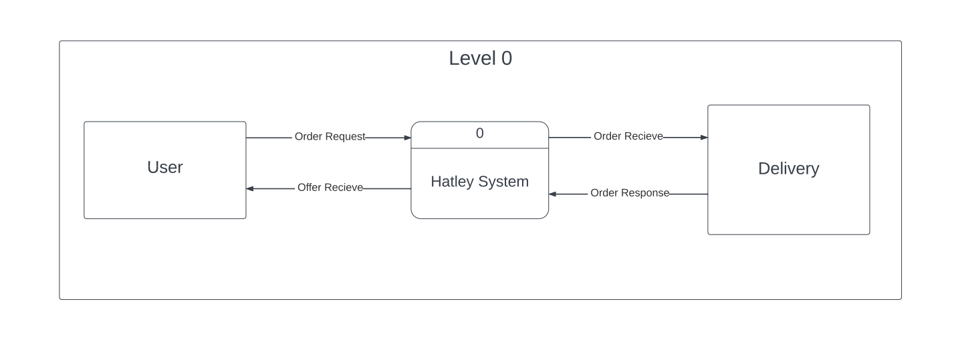
DFD Level 0

Slide 27
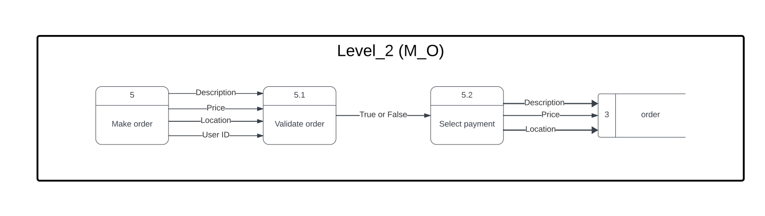
DFD Level 2 make order

Slide 28
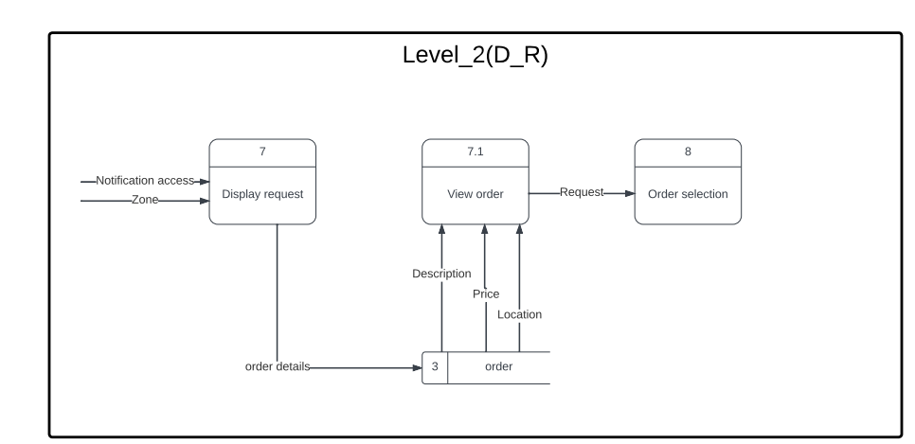
DFD Level 2 Display Request

Slide 29
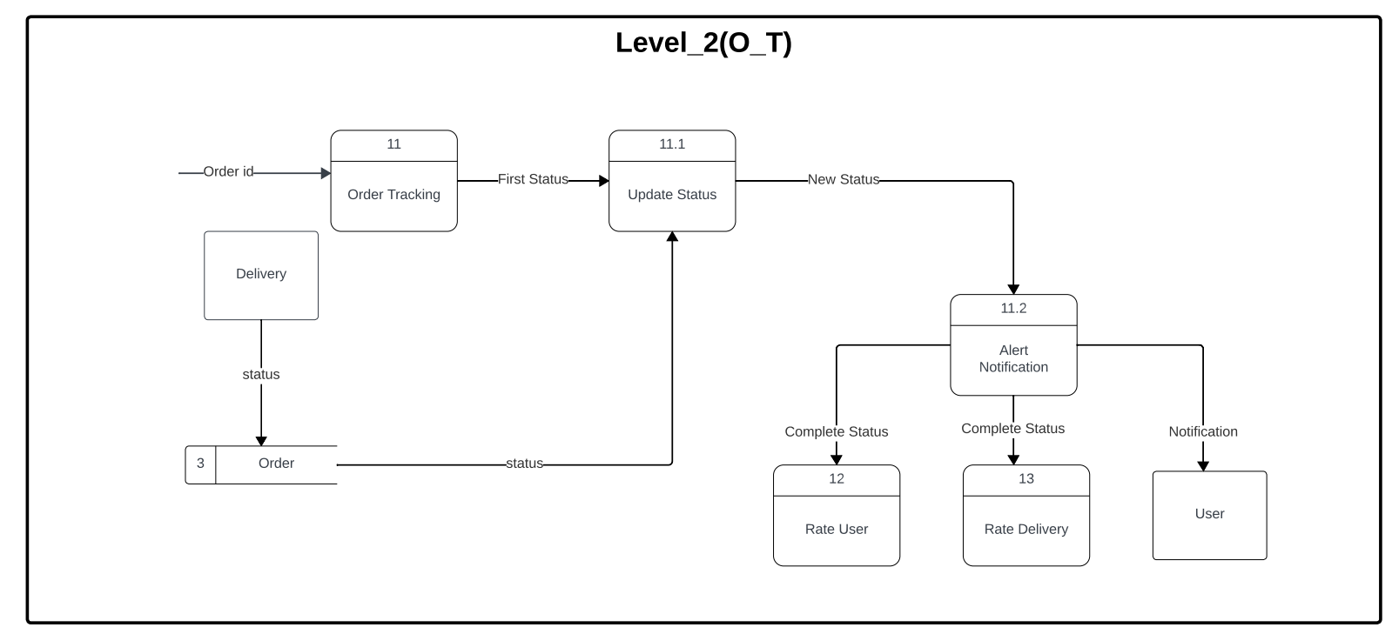
DFD Level 2 Order tracking

Slide 30
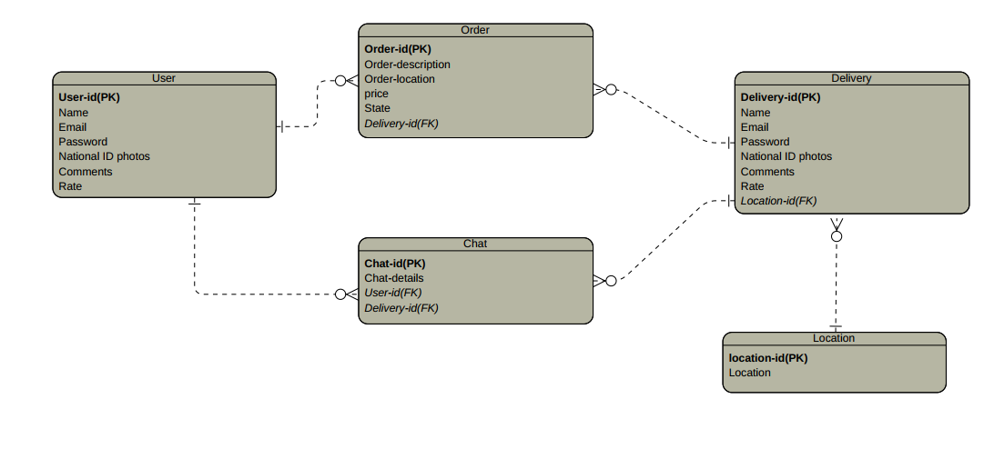
ERD

Slide 31
04
Prototype
How our app working

Slide 33
05
Conclusion

Slide 34
Technical Feasibility
01
Introduction
Overview of Technical Feasibility for Hatley App

Slide 35
Technical Feasibility
02
03
Familiarity with Web Application (Medium Risk)
Familiarity with Delivery System(Medium Risk)
The team has some experience with web application design and functions.
The team has limited knowledge of frameworks and real-world application functionality.
New features are still being studied.
The team has extensive experience in understanding the delivery application mechanism and the interaction between users and delivery.
Some team members have good user experience for app design and usability.

Slide 36
Technical Feasibility
04
05
Project Size(Low Risk)
Compatibility with Delivery App (Low Risk)
Sufficient team size for initial version of the app.
Long project timeline reduces deadline risk.
Lack of direct competitors at present.
Need for new, fast server to handle app users.
Planned marketing strategy to scale app delivery.

Slide 37
Economic Feasibility
01
Overall benefits:
The number of visits to the site has increased significantly over the years.
The percentage of each order also increases, which means an increase in revenue from each order.
Investments increase as the project develops and the volume of work increases.
The overall benefits increase significantly over the years.

Slide 38
Economic Feasibility
02
Costs
Development costs start in the first year .
Operational costs increase over the years, especially the costs of private servers and marketing.
The difference between the total benefits and costs begins to be negative in the second year, but becomes positive in subsequent years.

Slide 39
Economic Feasibility
03
Net cash flow
The results show that net cash was initially negative, but began to increase from the third year.
The return on investment is approximately 10.26%, which indicates the long-term viability of the project.
The point of sale will be approximately 2.733 years after the start of the project.

Slide 40
Organization Feasibility
01
Champion
The goal of the Hatley Project is to provide a distinctive delivery service that provides job opportunities for young people away from delivery companies exploiting them, facilitating the service for users so that it saves them the time and cost of ordering, the time required to complete the project is one year.

Slide 41
Organization Feasibility
01
organizational Management
we will support this project with budget 228,500EGP.

Slide 42
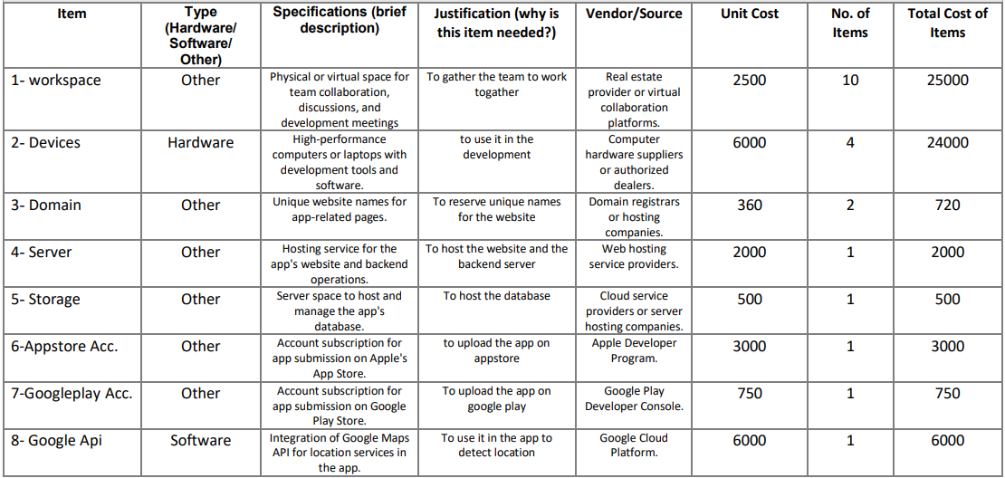
ESTIMATED EXPENSES

Slide 43
Last words

Slide 44
Thanks
Do you have any questions?
youremail@freepik.com
+91 620 421 838
yourwebsite.com
Please keep this slide for attribution

